Slide 1
MACHINING SCIENCE AND MACHINE TOOLS
MODULE IV

Slide 2
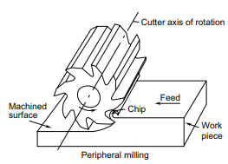
MILLING
the work piece is fed into a rotating milling cutter, which is a multi-point tool
Interrupted cutting: Each of the cutting edges removes material for only part of the rotation of the milling cutter. As a result, the cutting edge has time to cool before it removes material again. Thus the milling operation is much cooler compared to the turning operations seen earlier. This allows for much larger material rates

Slide 3
Machining operation that removes metal as the work is fed against a rotating multi point cutter
Teeth of the cutter removes the metal in the form of chips from the surface of the work to produce desired shape.
Work is held between centers or bolted to machine table
Revolving multi point cutter mounted either on spindle or arbor.
Cutter revolves at high speed and work fed slowly past the cutter.
Work can be fed in a vertical , horizontal or cross direction
As the work advances the cutter ,teeth removes metal from the surface to produce desired shape

Slide 4
Small size of chips: Though the size of the chips is small, in view of the multiple cutting edges in contact, a large amount of material is removed and as a result the component is generally completed in a single pass unlike the turning process which requires a large number of cuts for finishing.
Variation in chip thickness: This contributes to the non-steady state cyclic conditions of varying cutting forces during the contact of the cutting edge with the chip thickness varying from zero to maximum size or vice versa. This cyclic variation of the force can excite any of the natural frequencies of the machine tool system and would be harmful to the tool life and surface finish generated.

Slide 5
Types of Milling Machines
Column and knee type
Hand milling machine
Plain or Horizontal milling machine
Vertical milling machine
Universal milling machine
2. Fixed- bed type milling machine
Simplex;
Duplex;
Triplex
3. Planer type machines
4. Special purpose machines
Rotary table milling machine
Planetary milling machine
Pantograph milling machine
Tracer milling machine
Profile milling machine
Drum milling machine

Slide 6
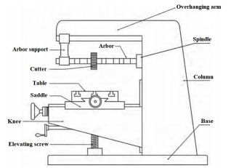
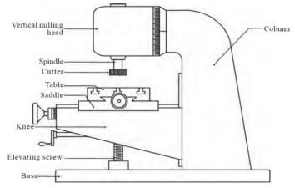
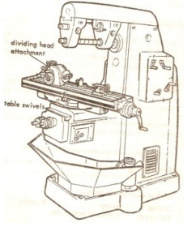
HORIZONTAL MILLING MACHINE
VERTICAL MILLING MACHINE
UNIVERSAL MILLING MACHINE

Slide 7
PARTS OF COLUMN AND KNEE TYPE MILLING MACHINE
BASE
Made of grey cast iron
Act as foundation member
Carries column at one end
Serves as a reservoir for coolants
2. COLUMN
Main supporting frame mounted vertically on the base
Houses all the driving mechanism for spindle and table feed
Front vertical face is provided with guide ways for supporting the knee.
3. KNEE
Portion which projects from column and is made to slide up and down
Position of knee can be adjusted by an elevating screw provided below the knee.

Slide 8
4. SADDLE
• Support and carries the table.
Slides on guide ways provided on the top of the knee
5. TABLE
Table rests on ways on the saddle and travels longitudinally
Acts as a support for the work
T- slots are provided for clamping the work and other fixtures
A lead screw under the table is used to move the table horizontally
In universal machines, table may swiveled horizontally on a circular base.
6. OVERHANGING ARM
Mounted on the top of the column
Serves as a bearing support for the other end of the arbor.

Slide 9
7. SPINDLE
Located in the upper part of the column
Receives power from electric motor through belts and gears
Spindle drive arbor.
8. ARBOR
Extension of spindle on which milling cutters are mounted
Provided with taper shank that fits into machine spindle having taper hole at their nose
Position of arbor can be adjusted with spacers
Draw bolt is used for locking arbor with spindle

Slide 10
In vertical milling machine most of the construction is very similar to the horizontal axis type except the spindle type and location.
The spindle is located in the vertical direction and is suitable for using the shank mounted milling cutters such as end mills.
In view of the location of the tool, the setting up of the work piece and observing the machining operation is more convenient.
The vertical axis milling machine is more flexible and suitable for machining complex cavities such as in die cavities in tool rooms.
Also the vertical head is provided with swivelling facility in horizontal direction whereby the cutter axis can be swivelled. This is useful for tool rooms where more complex milling operations are carried out.
The universal machine has the table, which can be swivelled in horizontal plane about 45° to either the left or right.
This makes the universal machine suitable for milling spur and helical gears, as well as worm gears and cams.

Slide 11
BED TYPE MILLING MACHINES
In production milling machines it is desirable to increase the metal removal rates. If it is done on conventional machines by increasing the depth of cut, chatter is likely to result.
Hence another variety of milling machines named as the bed type machines, which are made more rugged and consequently are capable of removing more material.
The ruggedness is obtained as a consequence of the reduction in the versatility. The table in the case of bed type machines is directly mounted on the bed and is provided with only the longitudinal motion.
The spindle will be moving along with the column to provide the cutting action.
Simplex machines are the ones with only one spindle head while the duplex machines have two spindles. The two spindles are located on either side of a heavy work piece and normally remove material from both sides simultaneously.

Slide 12
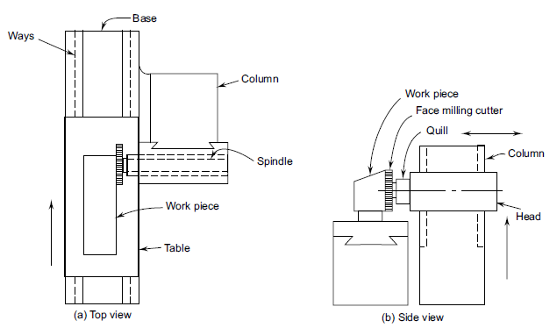
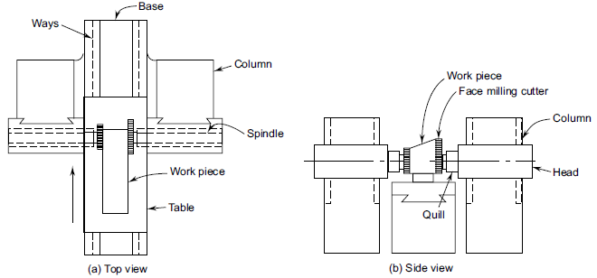
Simplex Bed type Milling Machine
Duplex Bed type Milling Machine

Slide 13
Milling Cutters
Types
Based on construction
Solid
Inserted Tooth type
2. Based on Mounting
Arbour Mounted
Shank Mounted
Nose Mounted
3. Based on rotation
Right Hand rotation (Counter Clockwise)
Left Hand Rotation (Clockwise)
4. Based on Helix
Right Hand Helix
Left Hand Helix
Milling cutters are generally made of high speed steel or cemented carbides. The cemented carbide cutters can be with brazed tip variety or more commonly with indexable tips. The indexable variety is more common since it is normally less expensive to replace the worn out cutting edges than to regrind them.

Slide 14
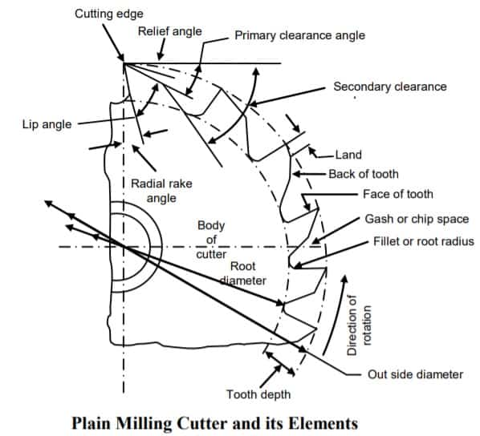
MILLING CUTTER AND ITS ELEMENTS

Slide 15
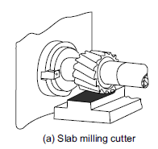
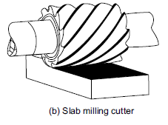
Plain Milling Cutters
These are also called slab milling cutters and are basically cylindrical with the cutting teeth on the periphery
These are generally used for machining flat surfaces
Light duty slab milling cutters generally have a face width, which is small of the order of 25 mm. They generally have straight teeth and large number of teeth.
The heavy duty slab milling cutters come with smaller number of teeth to allow for more chip space. This allows taking deeper cuts and consequently high material removal rates.
Helical milling cutters have a very small number of teeth but a large helix angle. This type of cutter cuts with a shearing action, which can produce a very fine finish. The large helix angle allows the cutter to absorb
most of the end load and therefore the cutter enters and leaves the work piece very smoothly.

Slide 16
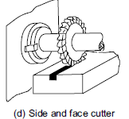
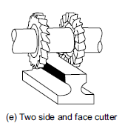
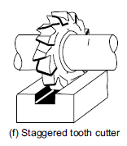
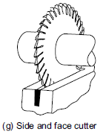
Side and Face Milling Cutters
These have the cutting edges not only on the face like the slab milling cutters, but also on both the sides. As a result, these cutters become more versatile since they can be used for side milling as well as for slot milling.
Staggered tooth side milling cutters are a variation where the teeth are arranged in alternate helix pattern.
This type is generally used for milling deep slots, since the staggering of teeth provides greater chip space.
Another variation of the side and face cutter is the half side milling cutter, which has the cutting edge only on one side. This arrangement will allow a positive rake angle and will be useful for machining on only one side.
These have much smoother cutting action and long tool life. The power consumed is also less for these cutters.

Slide 17
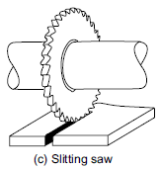
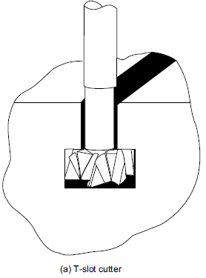
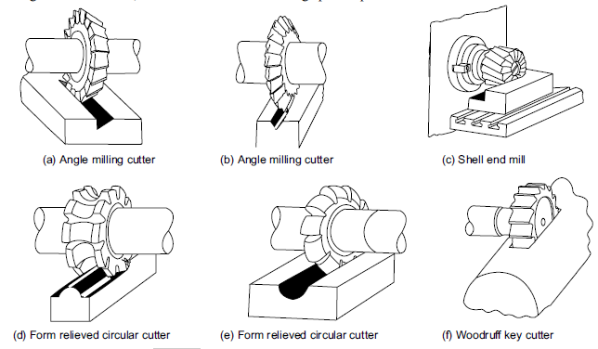
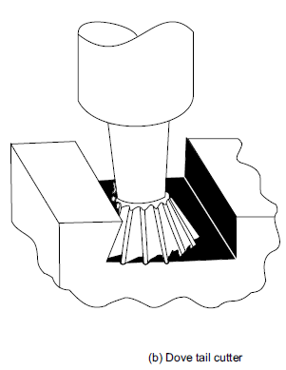
Slitting Saws
The other common form of milling cutters in the arbour mounted category is the slitting saw. This is very similar to a saw blade in appearance as well as function.
Most of these have teeth around the circumference while some have side teeth as well. The thickness of these cutters is generally very small and is used for cutting off operation or for deep slots.
Special Form Cutters

Slide 18
End Mills
These are shank mounted and are generally used in vertical axis milling machines. They are used for milling slots, key ways and pockets where other type of milling cutters cannot be used. A depth of cut of almost half the diameter can be taken with the end mills.
The end mills have the cutting edge running through the length of the cutting portion as well as on the face radially upto a certain length. The helix angle of the cutting edge promotes smooth and efficient cutting even at high cutting speeds and feed rates. High cutting speeds are generally recommended for this type of milling cutters.

Slide 19
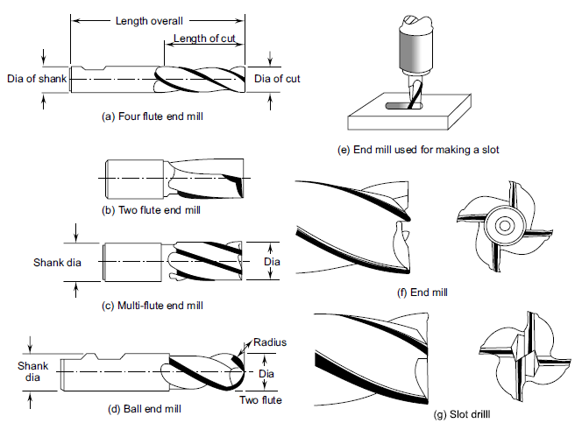

Slide 20
Based on the directions of movement of the milling cutter and the feeding direction of the work piece, there are two possible types of milling:
UPMILLING
In up milling the cutting tool rotates in the opposite direction to the table movement. In the conventional or up milling, the chip starts at zero thickness and gradually increases to the maximum size
This tends to lift the work piece from the table.
There is a possibility that the cutting tool will rub the work piece before starting the removal. However, this process is inherently safe.
The initial rubbing of the cutting edge during the start of the cut in up milling tends to dull the cutting edge and consequently have lower tool life.
Also since the cutter tends to cut and slide alternatively, the surface generated is left with the machining marks.

Slide 21
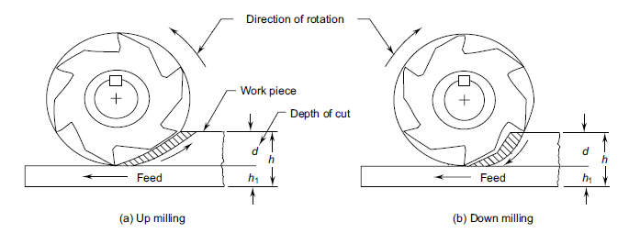
DOWN MILLING
In down milling the cutting tool rotates in the same direction as that of the table movement. In the climb or down milling, the chip starts at maximum thickness and goes to zero thickness gradually
This is suitable for obtaining fine finish on the work piece. The cutting force will act downwards and as such would keep the work piece firmly in the work holding device. This is good for thin and frail work pieces.
In down milling, though the cut starts with a full chip thickness, the cut gradually reduces to zero.
This helps in eliminating the feed marks present in the case of up milling and consequently better surface finish. Climb milling also allows greater feeds per tooth and longer cutting life between regrinds than the conventional milling.

Slide 22
INDEXING METHODS
INDEXING HEAD OR DIVIDING HEAD
Indexing is the operation of dividing the periphery of a work into any number of equal parts.
Eg: In cutting spur gear, hexagonal and square bolt, splines on shaft equal spacing of teeth on the gear blank is performed by indexing
Indexing is accomplished by using a special attachment known as dividing head or index head

Slide 23
DIVIDING HEAD
Dividing head is one of the most important attachments with the milling machine and it is almost indispensable.
The main spindle of the dividing head drives the work piece by means of a 3-jaw universal chuck or a dog and live centre similar to a lathe
The index plate of a dividing head consists of a number of holes with a crank and pin.
The index crank drives the spindle and the live centre through a worm gear, which generally has 40 teeth
a full rotation of the work piece is produced by 40 full revolutions of the index crank.
Further indexing is made possible by having the index plates with equi-spaced holes around various circles.
This would allow for indexing the periphery of the work piece to any convenient number of divisions.

Slide 24
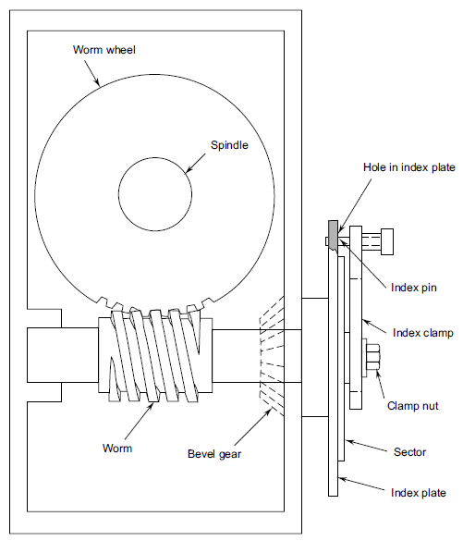

Slide 25
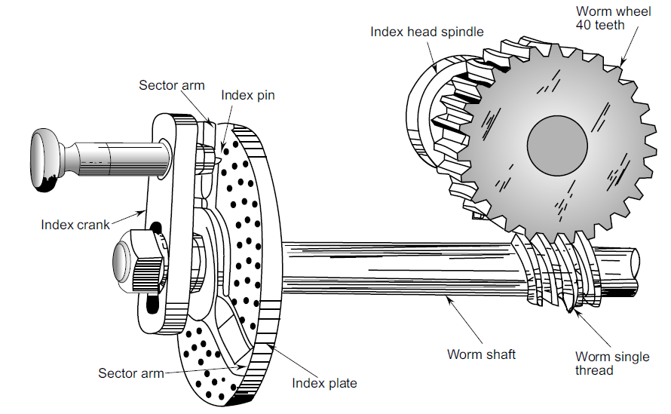
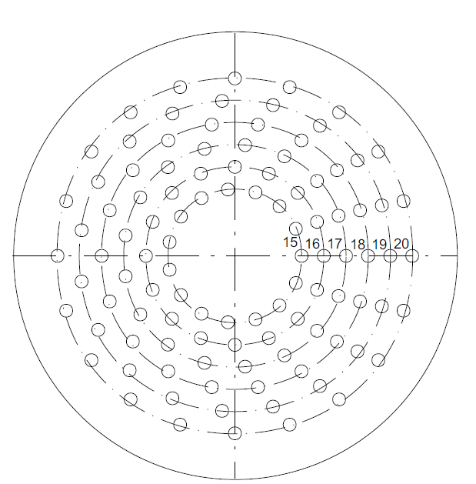
BROWN AND SHARP DIVIDING HEAD

Slide 26
The index plates available with the Brown and Sharpe milling machines are
Plate no. 1: 15, 16, 17, 18, 19, 20 holes
Plate no. 2: 21, 23, 27, 29, 31, 33 holes
Plate no. 3: 37, 39, 41, 43, 47, 49 holes
The index plate used on Cincinnati and Parkinson dividing heads is
Plate 1: Side 1 24, 25, 28, 30, 34, 37, 38, 39, 41, 42 and 43 holes
Side 2 46, 47, 49, 51, 53, 57, 58, 59, 62 and 66 holes
It is also possible to get additional plates from Cincinnati to increase the indexing capability as follows:
Plate 2: Side 1 34, 46, 79, 93, 109, 123, 139, 153, 167, 181, 197 holes
Side 2 32, 44, 77, 89, 107, 121, 137, 151, 163, 179, 193 holes
Plate 3: Side 1 26, 42, 73, 87, 103, 119, 133, 149, 161, 175, 191 holes
Side 2 28, 38, 71, 83, 101, 113, 131, 143, 159, 173, 187 holes

Slide 27
SIMPLE OR PLAIN INDEXING
Universal Dividing Head is used for this
The Indexing plate should be locked with the body
Worm and worm gear is to be engaged
To index the work ,the index crank pin is withdrawn from the hole of the index plate, turn the index crank through calculated number of whole revolutions and holes on one of the hole circles
After required position is reached it is again locked by crank pin
40 turns of indexing crank = 1 revolution of index head spindle
Index plates with concentric circles of holes are used:

Slide 28
Plate: 1 - 15, 16, 17, 18, 19, 20
Plate: 2 - 21, 23, 27, 29, 31, 33
Plate: 3 – 37, 39, 41, 43, 47, 49
Index crank movement = 40/N (N = number of divisions required)
If the index crank movement deducted from above formula is a whole no. then the index crank should be rotated through a complete no. of turns equal to derived whole no.
Suppose it is desired to mill a gear with 8 equally spaced teeth. l/8 th of 40 or 5 turns will produce correct spacing.
i.e. after each milling operation we will rotate the index crank by 5 turns until work is completed.
If index crank movement calculated from above formula is a whole no. and fraction, the numerator and denominator are multiplied by a suitable common no. so that the denominator will turn to a number equal to no. of holes available on any of the index plate

Slide 29
The new numerator now stands for the no. of holes to be moved by the index crank in the selected whole circle in addition to complete turns of index crank
For cutting 16 teeth, 40/16 = 2 turns. i.e. for each indexing we need two complete rotations of the crank plus 8 more holes on the 16 hole circle of plate 1(Plate I - 15, 16, 17, 18, 19, 20 holes)
For cutting 30 teeth, 40/30 = 1 + 1/3 = 1 + 7/21 (One complete turn of indexing crank and 7 holes in 21 hole circle of the index plate 2)

Slide 30
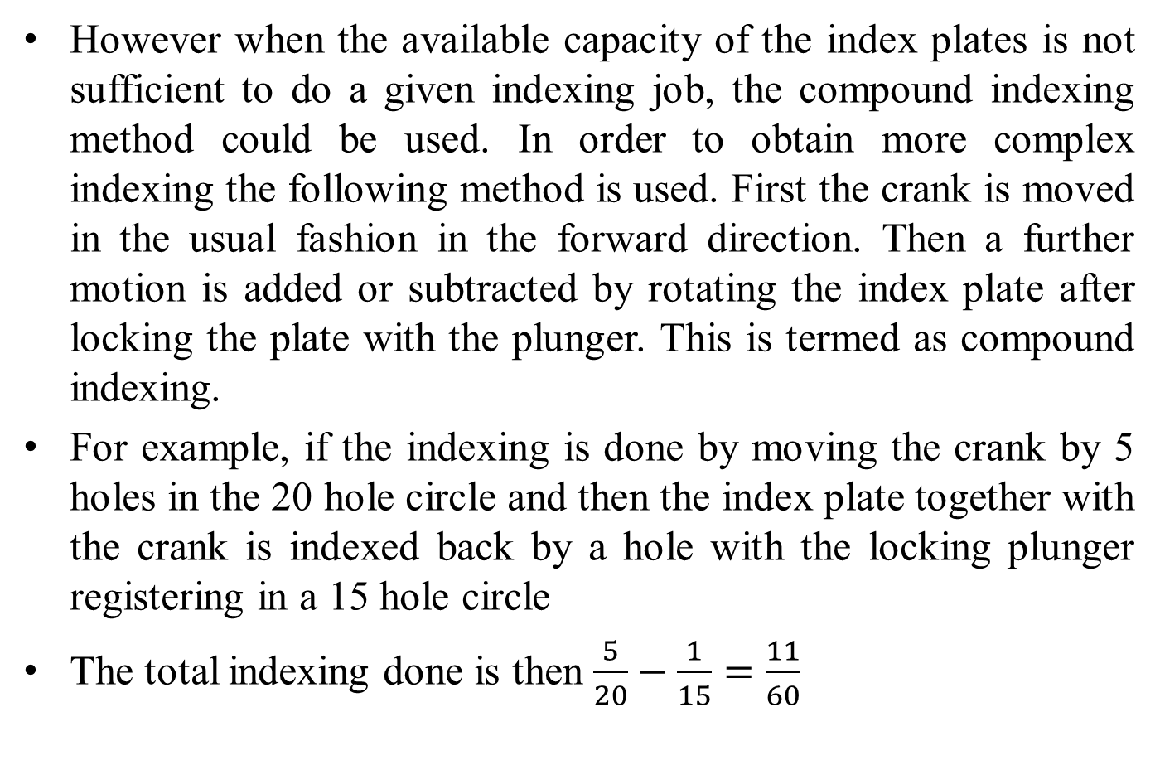
COMPOUND INDEXING
However when the available capacity of the index plates is not sufficient to do a given indexing job, the compound indexing method could be used. In order to obtain more complex indexing the following method is used. First the crank is moved in the usual fashion in the forward direction. Then a further motion is added or subtracted by rotating the index plate after locking the plate with the plunger. This is termed as compound indexing.
For example, if the indexing is done by moving the crank by 5 holes in the 20 hole circle and then the index plate together with the crank is indexed back by a hole with the locking plunger registering in a 15 hole circle
The total indexing done is then $\frac{5}{20}−\frac{1}{15}=\frac{11}{60}$

Slide 31
Angular Indexing
Sometimes it is desirable to carry out indexing using the actual angles rather than equal numbers along the periphery, then angular indexing would be useful.
The procedure remains the same as the previous cases, except that the angle will have to be first converted to equivalent divisions.
Since the 40 revolutions of the crank equals to a full rotation of the work piece, which means 360°, then one revolution of the crank is equivalent to 9°.

Slide 32
Differential Indexing
differential indexing is used for that purpose which is an automatic way to carry out the compound indexing method
In differential indexing, the index plate is made free to rotate. A gear is connected to the back end of the dividing head spindle while another gear mounted on a shaft, is connected to the shaft of the index plate through bevel gears
Since the work piece spindle is connected to the index plate through the intermediate gearing as explained above, the index plate will also start rotating.
If the chosen indexing is less than the required one, then the index plate will have to be moved in the same direction as the movement of the crank, to add the additional motion.
If the chosen indexing is more then the plate should move in the opposite direction to subtract the additional motion.
The direction of the movement of the index plate depends upon the gear train employed.
If an idle gear is added between the spindle gear and the shaft gear in case of a simple gear train, then the index plate will move in the same direction to that of the indexing crank movement.
In the case of a compound gear train an idler is to be used when the index plate is to move in the opposite direction.

Slide 33
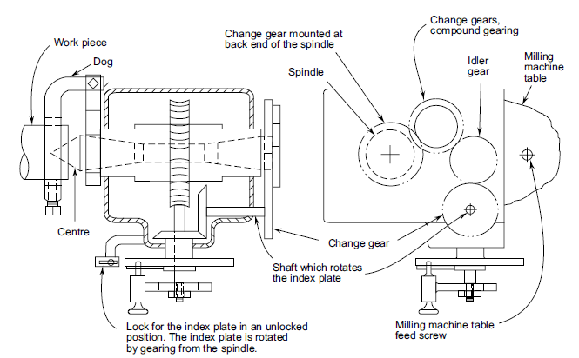


Slide 34
GRINDING
It is the process of removing metal in small quantities by using abrasive wheel.
It is regarded as a finishing process.
It used for obtaining desired surface finish, accuracy in size and geometrical configuration of the product.
Grinding wheel
It is a multipoint cutting tool.
It is composed of abrasive grains held together with a suitable bond.
Each abrasive grain will act as an individual cutting tool and removes the metals in the form of small chips.

Slide 35
ADVANTAGES OF GRINDING.
The surface finish obtained is superior to that of any other machine tool, and is also one of the most dimensionally accurate machining processes.
Hardened components can be machined by grinding, which would be difficulty or even impossible for other machine tools.
Grinding requires very little pressure permitting its use on light and delicate parts.
DISADVANTAGES OF GRINDING
Work surface gets over heated.
Wheel chatter and vibrations result inaccuracies, and duplicate pieces do not have the same dimensions.
Grinding is not suitable as a machining process where high metal removal is required.

Slide 36
ABRASIVES
It is a small non-metallic hard particle having sharp edges and an irregular shape.
They are capable of removing small amount of materials from the surface in the form of small chips.
Characteristics of abrasives
Must be harder than material being grind.
Must be strong enough to withstand grinding pressure.
Must be heat resistant.
Must be capable to break when the cutting edge is dull.

Slide 37
Types of Abrasives
1. Natural abrasives
These are obtained from earth’s crust which includes sand stone, emery, corundum & diamond.
Sand stone is relatively soft and can’t be used for grinding harder materials.
Emery & corundum are natural aluminum oxides, and have a greater hardness and better abrasive action than quartz.
Diamond is one of the best natural abrasive but due to high cost its use is limited to grinding cemented carbides, glass, marbles & garnets.
Due to lack of uniformity and contain a high percentage of impurities. They have been almost totally replaced by artificial abrasives.
2. Artificial abrasives
It is used extensively because their characteristics can be easily controlled
Aluminium Oxide (Al2O3)
This is one of the natural abrasives found called corundum and emery. However the natural abrasives generally have impurities and as a result their performance is inconsistent.
Hence the abrasive used in grinding wheels is generally manufactured from the aluminium ore, bauxite.
b) Silicon Carbide (SiC)
Silicon carbide is made from silica, sand, and coke with small amounts of common salt.

Slide 38
c) Cubic Boron Nitride (CBN)
Cubic Boron Nitride (CBN) next in hardness only to diamond
It is not a natural material but produced in the laboratory using a high temperature/ high pressure process similar to the making of artificial diamond.
CBN is less reactive with materials like hardened steels, hard chill cast iron, and nickel base and cobalt based super alloys.
CBN grains have 55 times higher thermal conductivity, four times higher the abrasive resistance and twice the hardness of the aluminum oxide abrasives.
They can retain their strength above 10,000°C. CBN is very expensive, 10 to 20 times that of the conventional abrasive such as aluminium oxide.
d) Diamond
Diamond is the hardest known material that can be used as a cutting tool material.
It has very high chemical resistance along with low coefficient of thermal expansion.
Also it is inert towards iron.

Slide 39
Grain Size
Compared to a normal cutting tool, the abrasives used in a grinding wheel are relatively small.
The size of an abrasive grain, generally called grit, is identified by a number which is based on the sieve size used.
These would vary from a very coarse size of 6 or 8 to a super fine size of 500 or 600.
Sieve number is specified in terms of the number of openings per square inch. Thus larger the grain number finer is the grain size.
The fine grains would take a very small depth of cut and hence a better surface finish is produced. Also fine grains generate less heat and are good for faster material removal. Though each grain cuts less, there are more grains per unit surface area of the wheel in case of fine grain size.
Fine grains are also used for making the form grinding wheels.
Coarse grains are good for higher material removal rates. These have better friability and as a result are not good for intermittent grinding where they are likely to chip easily.

Slide 40
Bond
The function of the bond is to keep the abrasive grains together under the action of the grinding forces. The commonly used bond materials are:
Vitrified
This is the most commonly used bond. The bond is actually clay mixed with fluxes such as feldspar, which hardens to a glass like substance on firing to a temperature of about 1250°C and develops the strength.
This bond is strong, rigid and porous, and not affected by fluids.
However, this bond is brittle and hence sensitive to impacts.
This bond is also called ceramic bond.
Silicate
This is sodium silicate (NaSiO3) or water glass and hardens when heated.
Not as strong as vitrified.
This can be used in operations that generate less heat. It is affected by dampness but less sensitive to shocks.
Relatively less used.

Slide 41
Synthetic Resin or Resinoid
These bonding materials are thermosetting resin such as phenol formaldehyde.
This bond has good strength and is more elastic than the vitrified bond.
However, this is not heat and chemical resistant.
Generally used for rough grinding, parting off and high speed grinding (50 to 65 m/s).
It can also be used for fine finishing of roll grinding.
Rubber
Of all the bonds used, this is the most flexible. The bond is made up of natural or synthetic rubber.
The strength is developed with vulcanisation.
This has high strength and is less porous.
This bond is affected by dampness and alkaline solutions.
Generally used for cutting off wheels, regulating wheels in centre less grinding and for polishing wheels.
Shellac
This is relatively less used bond. Used generally for getting very high finish.
Typical applications are rolls, cutlery, and cam shaft finishing.

Slide 42
Metal
This is used in the manufacture of diamond and CBN wheels.
The wheel can be made of any high thermal conductive metal such as copper alloys or aluminium alloys.
The periphery of the wheel up to a small depthof the order of 5 mm or less contains the abrasive grit.
The choice of the metal depends on the required strength, rigidity and dimensional stability.
In view of the strong bond, the grit will not be knocked out till it is fully utilised.
Powder metallurgy techniques are used to make the abrasive periphery.

Slide 43
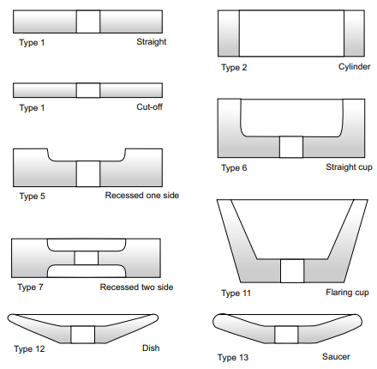
Grinding wheel types

Slide 44
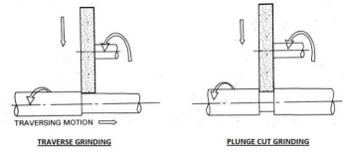
Types of grinding machines
Centre type cylindrical grinders
In which work is mounted between centers & rotated against the wheel.
The work must pass through wheel or Vic versa.
Transverse grinding
Plunge cut grinding
Transverse grinding
Work reciprocates as the wheel feeds into the work
This operation produce cylindrical shapes longer than the width of the wheel
Plunge cut grinding
Work rotates in fixed position and the wheel is fed into the work until the required dia.
The length of cylindrical shape produced is equal to the width of the wheel

Slide 45
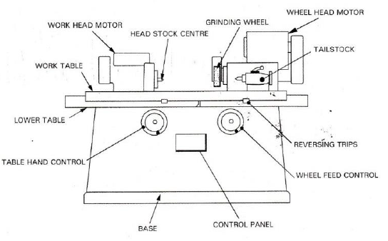
CYLINDRICAL GRINDING
The plain cylindrical grinding machine has the following parts,
1. Bed or Base
2. Table
3. Headstock
4. Tailstock or Foot stock
5. Wheel head

Slide 46
In cylindrical grinders the work is mounted between the centers and rotated against the grinding wheel.
The work may also be held in a chuck for certain operations.
The various movements involved in a cylindrical grinding are given below,
1. The work must revolve.
2. The wheel must revolve.
3. The work must pass the wheel or the wheel must pass the work.
4. The movement of wheel into the work or work into the wheel.

Slide 47
Base:
The base or bed rests on the floor. The top of the base is machined accurately to form ways for the table. It also houses the table drive mechanism.
Table:
The lower table mounted on the ways of the bed. It provides traverse motion to the work past the grinding wheel. It can be operated manualy.
Upper table:
It is mounted on lower table and can be swivelled for grinding tapers and alignment purposes. The head stock and tail stock are mounted on this table.
Head stock:
Head stock supports and drive the work piece with the help of centre and dog or chuck

Slide 48
Tailstock:
Tailstock or foot stock is mounted on the right end of the table. It can be adjusted along the length of the bed to support the right end of the work.
Wheel head:
Wheel head is mounted on a cross-slide at right angle to the table, providing the in-feed movement of the wheel to the work.

Slide 49
CENTRELESS GRINDING
Centre less grinding makes it possible to grind cylindrical work pieces without actually fixing the work piece using centres or a chuck. As a result no work rotation is separately provided
In which the work is supported by a combination of a work rest blades
Two wheels are used, one is grinding wheel and other is regulating wheel
Its performed on work which does not have centers
It reduces the total operation time by eliminating need for center holes in the work piece
The grinding wheel rotates at higher speed than the regulating wheel.
Regulating wheel control the rotation of work piece

Slide 50
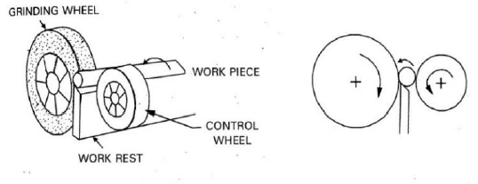
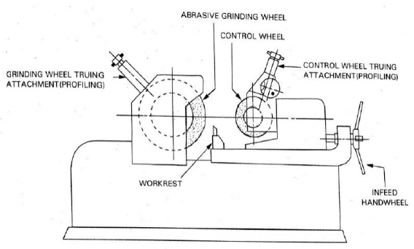

Slide 51
ADVANTAGES
1. There is no need for having and maintaining centres and centre holes.
2. Work pieces can be loaded and unloaded from the machine rapidly. Grinding is almost continuous for through feed grinding.
3. Backing up the work piece by the regulating wheel and work rest blade practically eliminates any deflection of the work piece. This permits maximum material removal rates.
4. Minimum wear is observed in view of the large grinding wheels used. This minimises the adjustments needed for staying within dimensional tolerances and maximises the periods of time between wheel dressings.
5. Work pieces may often be loaded into the machine by the automatic feeding devices.
6. Less grinding allowance may be required, because the out-of-roundness is corrected across the diameter rather than the radius.

Slide 52
Limitations of centre less grinding
1. Setup time for a centre less grinding operation is usually large.
2. This process is useful only for large volume production. It may be necessary to have special equipment and additional setup time for special profiles.
3. This process is not suitable for large work piece sizes.
INTERNAL CENTRELESS GRINDING
It is also possible to apply centre-less grinding for internal surfaces as well. However, in this case, the work piece needs to be supported by two support Rolls
The main advantage of the process is that the ground hole will be concentric with the outside diameter of the work.
The process is capable of grinding straight cylindrical or tapered holes.
These holes can be blind, through, interrupted, or even with a shoulder.

Slide 53
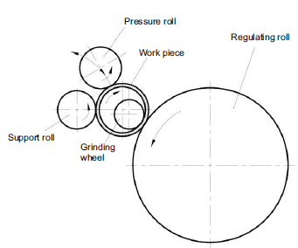
First support roll is mounted below the work to support it and control the distance from the work centre.
The second support roll is a pressure roll and holds the work in contact with the other two. This roll moves in and out to allow for loading and unloading the machine.
The third roller as shown is the regulating roll that drives the work and controls its speed and direction.
The grinding wheel remains in a fixed position, and the work traverses past the grinding wheel. This is almost similar to through feed center-less grinding with simplified setup and automatic loading of work pieces.

Slide 54
FINISHING OPERATIONS
The heat generated during grinding tends to disrupt and distort the surface of the work, this result in poor surface finish.
After machining some components undergo a further process in order to improve the accuracy and surface finish.
Such operations include lapping, honing, super finishing, polishing, burnishing, etc.

Slide 55
LAPPING
Lapping is an abrasive process used to improve the surface finish and to obtain small changes in dimensions or to obtain almost perfect contact
between two mating surfaces.
Lapping consist of rubbing work surface with lap surface which is charged with fine abrasive particles.
The lap material is generally softer than the work material.
Graphite in the cast iron serves to hold the abrasive particles and provides lubricating effect.
Narrow grooves are cut on lap surface and are then charged by spreading and pressing the abrasive particles over the surface of the lap.
Silicon carbide is used for rapid stock removal & aluminium oxide for improve surface finish.
The work piece is then held against the lap & moved in unrepeated path.
Suitable cutting fluid such as oil is applied for lapping.

Slide 56
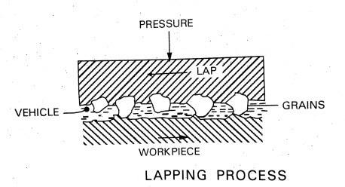
The lapping pressure is generally kept in the range of 0.01 – 0.2/mm2.
The lapping can be done by hand or by machine.
In hand lapping either lap or the work is held by hand and a relative motion is produced between them.
Machine lapping is performed for obtaining highly finished surfaces in mass production.

Slide 57
Advantages
Less heat generated, and there is no distortion of work surface
Due to low temperature, there are no metallurgical changes in the work materials.
The process is suitable for ant materials, and can be used for finishing flat or cylindrical surfaces and holes.
Disadvantages
The process is very slow and metal removal rate is low.
Hand lapping requires high operation skill.
Process cost is high.
Applications:
Lapping is employed for getting precise surface finish on precision tool, gauges, bearings, valves, valves seats. This process can applied for both metal & non-metals.

Slide 58
HONING:
Honing is a finishing process in which honing tool rotates and reciprocates in the stationary hole being honed.
It is used on holes and bores, which require a fine surface finish and a high degree of accuracy.
For honing, the hone is inserted into the hole and adjusted to bear against the walls.
Work is kept stationary, and the metal is removed as a result of rotary as well as reciprocating motion of the hone in the hole.
A cutting fluid is used to remove chips and to keep temperature low.
It is important to see that the hone should not leave the work surface and stroke length must cover the entire work length.
Honing can be performed on lathe or drilling machine, but better results can be obtained on honing machines for production work.

Slide 59
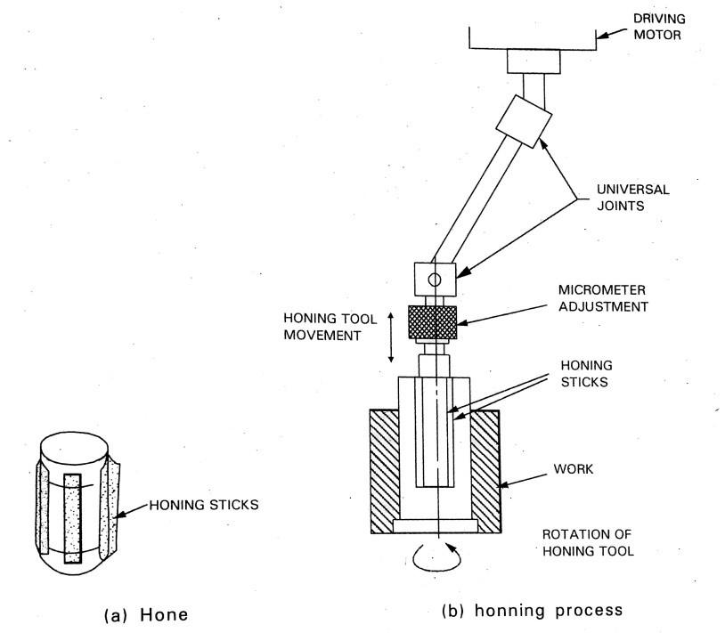
Advantages
Hole of any diameter or length can be finished.
Relatively high productivity & low cost with other finishing methods.
Remove considerable amount of material & it is faster.
Disadvantages
Honing cannot correct diametric or axial run-out of the bore
It is not suitable for tough non-ferrous metals due to glazing.
Applications
It is employed for gun barrels, bearing holes, valve guides, bushes, diesel engine cylinder bore, hub holes in gears & gear box, etc.

Slide 60
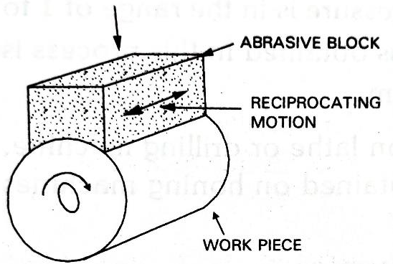
SUPER FINISHING
Super finishing is a special technique for producing fine quality surface finish by using abrasive stick.
In super finishing, tool reciprocates with short strokes across the surface of the rotating work piece.
Controlled amounts of pressure are applied to the abrasive stick to affect the surface cutting.
Super finishing is applied for external or internal surfaces which have been previously ground or precision turned.
Parts made from cast iron, steel or non-ferrous metals can be successfully super finished.

Slide 61
Advantages
Due to large area of contact minute imperfections left by grinding or other machining process are completely eliminated.
Low working temperature due to low heat generation.
Disadvantages
Macro-geometrical errors can’t be corrected by super finishing.

Slide 62
JIGS AND FIXTURES
JIG: it is a work holding device also locater or guides the cutting tool with respect to the work piece
FIXTURE: it is a work holding device but does not locates or guides the cutting tool

Slide 63
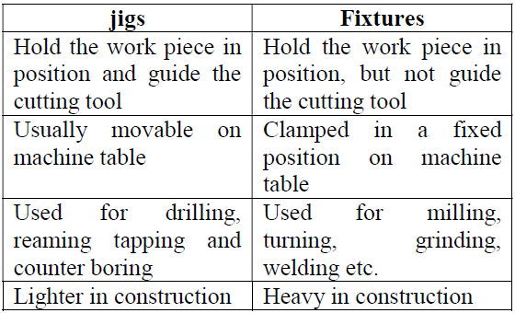
DIFFERENCE BETWEEN JIGS AND FIXTURES

Slide 64
ADVANTAGES OF JIGS AND FIXTURES
Reduce the operation time, and increases productivity
Facilitates uniform quality and ensures inter changeability of component
Unskilled operators can do the job, thus saving in labour cost
Ensures higher accuracy and surface quality
Reduce the overall cost of product

Slide 65
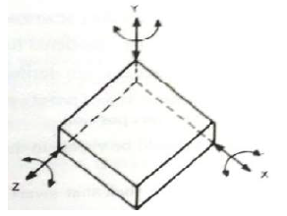
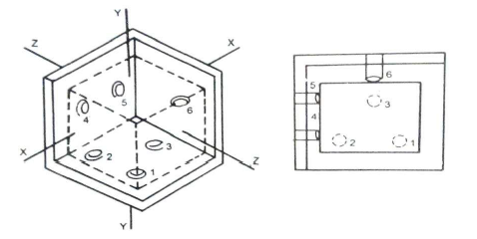
PRINCIPLES OF LOCATION
An object in space has 6 digress of freedom.3 linear movements along x, y and z axes and 3 rotations about these 3 axes.
Locating means preventing the degrees of freedom of the work piece when it is placed in the jig or fixture. It can be done by providing pins at correct positions as follows
Pins 1,2,3:-prevent linear motion along y and rotation about z and x
Pins 4,5:-Prevent linear motion along z and rotation about y
Pin 6:-Prevent linear motion along x

Slide 66
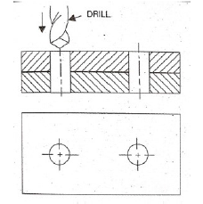
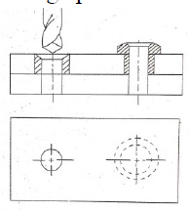
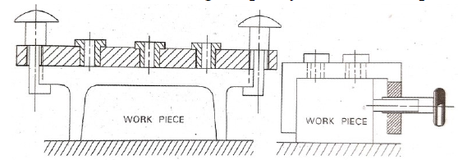
TYPES OF DRILL JIGS
1. Template jig
Used when making holes
Contains holes to guide the tool and is used directly over the component
2. Plate jig
Template jigs in which drill buses are provided is called plate jig, used for accurate drilling on large parts
3. Channel jig
It is in the form of standard channel
Component is located in a channel and is clamped by screw
Used for drilling simple symmetrical shapes

Slide 67
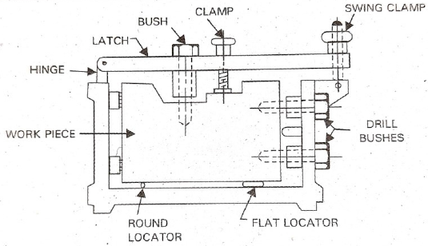
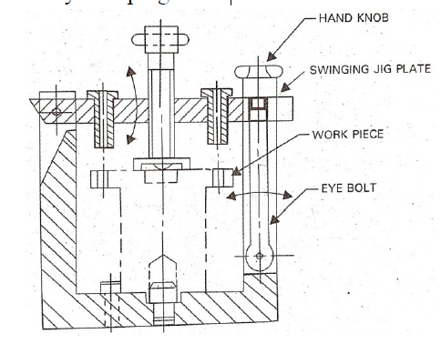
4. Box jig
Used when drilling is required on more than one plane
The body of the jig is made of box like structure in which the component is located
One side of the box would be fitted with cam or latch to provide the necessary opening for inserting the component and unloading it
5. Leaf or latch jig
Drill jig with a hinged jig plate in which one or more drill bushes are fitted
Jig plate must be positively located such that the axes of bushes are vertical during drilling
Latch is clamped by nut and the work piece by clamping screw

Slide 68
6. Indexing jig
Drill jig in which index plate is incorporated so that the work piece can be indexed successively for drilling series of holes on its surface under a single bushing
7. Universal jig
Universal or pump jigs are plate jigs with guide pillars
The guide pillars position the drill bushes correctly with respect to the work piece located on the base plate
The jig plate is lowered to touch and clamp the work piece, and after drilling it is raised to relieve the work piece
The jig plate is moved by handle which operates rack and pinion
Universal jigs are used for drilling work pieces having parallel surfaces

Slide 69
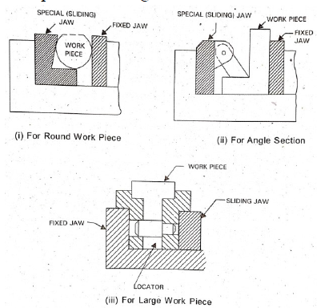
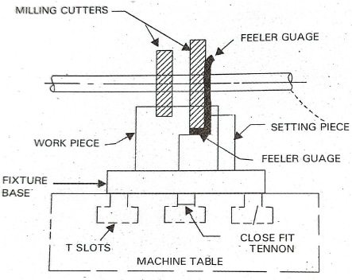
TYPES OF FIXTURES
1. Machine vices
The machine vice is the simplest form of fixtures used to hold the parts for machining
Special jaws are designed to accommodate off shaped work piece and at the same time to prevent damage to machined surfaces
2. Milling fixtures
The cutting force induced in milling is heavy and therefore, the fixture is rigidity attached to the table
Essentially consists of base, tenon strips, setting blocks, T-bolts, clamps and locating pins

Slide 70
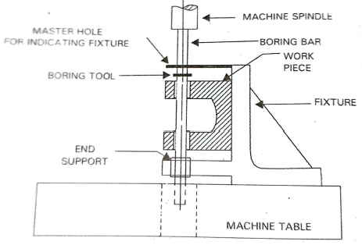
3. Boring fixture
Purpose is to guide the boring bar as in drilling or to hold the work piece in position
Not rigid because cutting force induced is smaller than milling

